Slide 1
Duplicate Detection

Slide 2
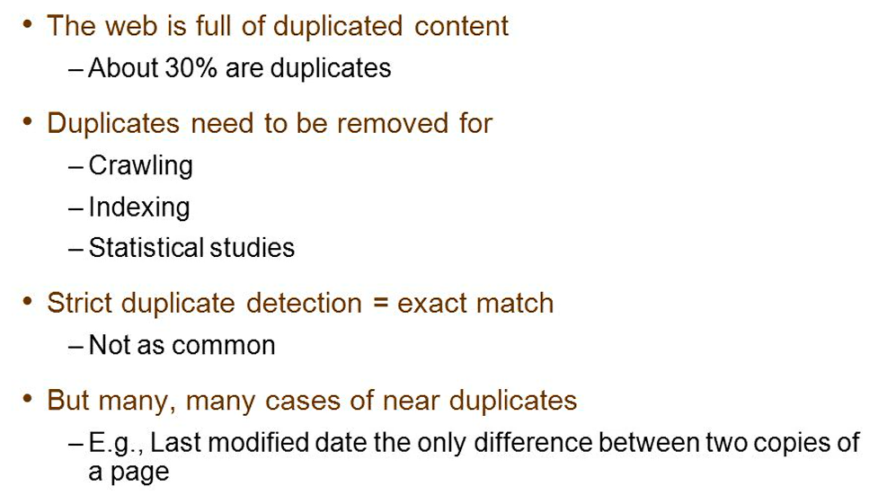
Duplicate documents

Slide 3
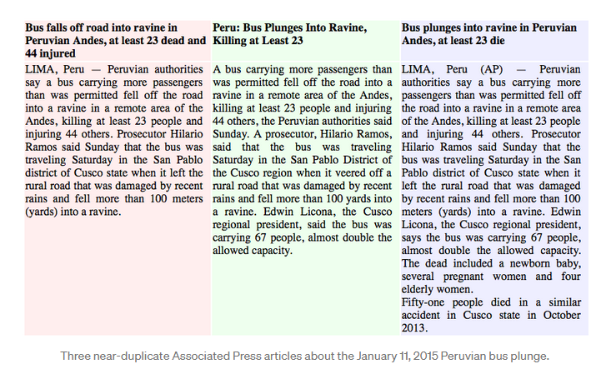

Slide 4
Near-duplicates and Shingling
Fingerprint – Edit Distance – minimal number of operations to edit A into B – example: spelling correction – mathematically elegant
Near duplicates - shingling
. k-shingles of a document d is the set of all consecutive
sequences of k terms in d
Example : a rose is a rose is a rose
a rose is a, rose is a rose , is a rose is ….
two documents are near duplicates if the sets of shingles generated from them are nearly the same
Jaccard Similarity(S(d1),S(d2))= |S(d1) ∩ S(d2)|/|S(d1) ∪ S(d2)|

Slide 5
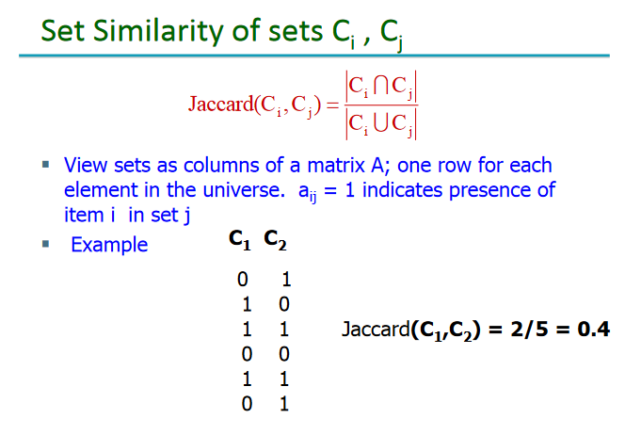

Slide 6
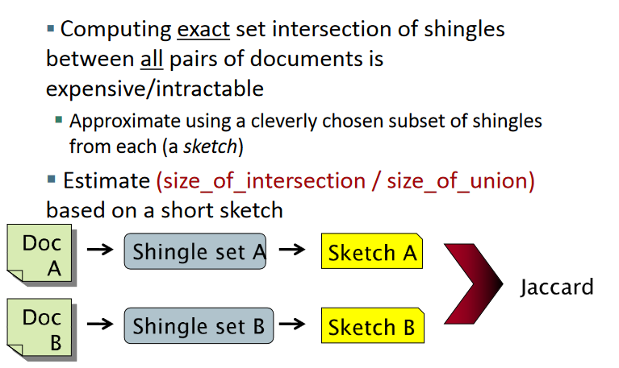

Slide 7
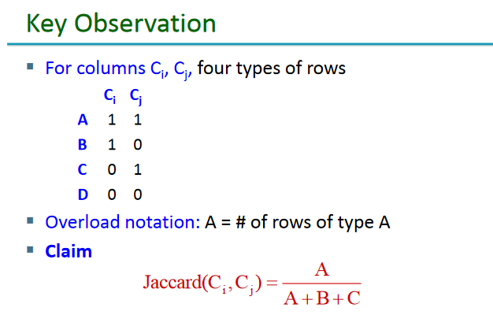

Slide 8
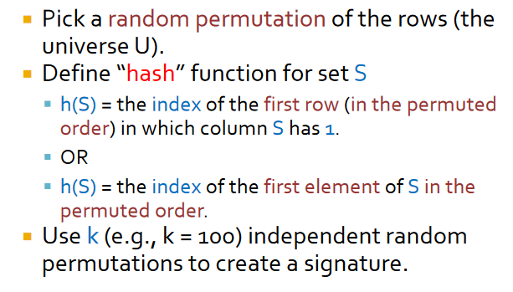
MinHash

Slide 9

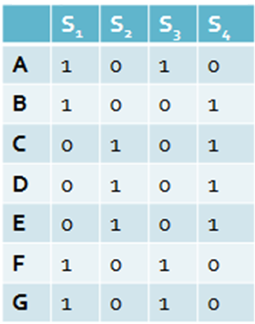
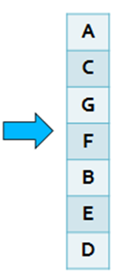

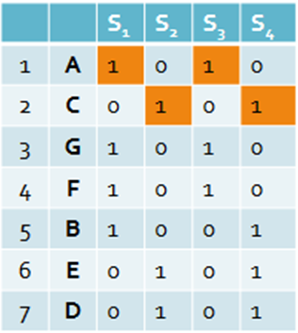













MinHash Example
There are four documents S1, S2, S3 and S4 and 7 Shingles A, B, C through G

Slide 10
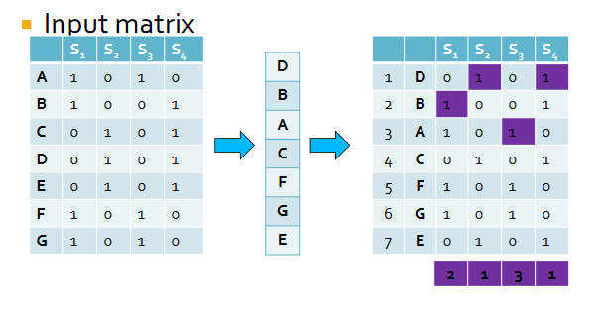
MinHash Example
There are four documents S1, S2, S3 and S4 and 7 Shingles A, B, C through G

Slide 11
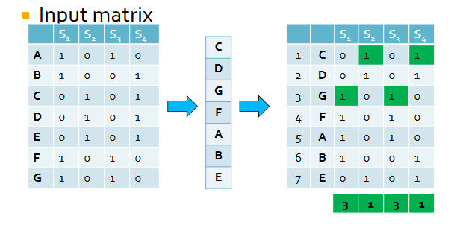
MinHash Example
There are four documents S1, S2, S3 and S4 and 7 Shingles A, B, C through G

Slide 12
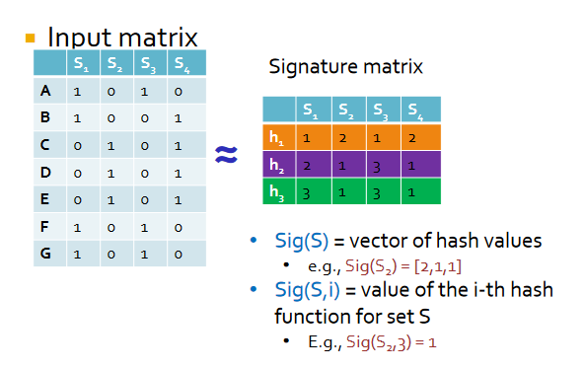
MinHash Example
There are four documents S1, S2, S3 and S4 and 7 Shingles A, B, C through G

Slide 13
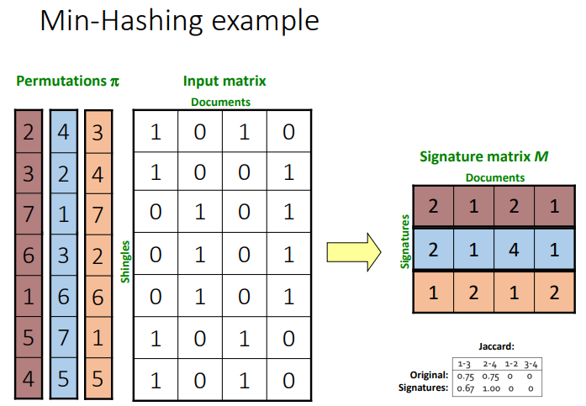
There are four documents S1, S2, S3 and S4 and 7 Shingles A, B, C through G

